Slide 1
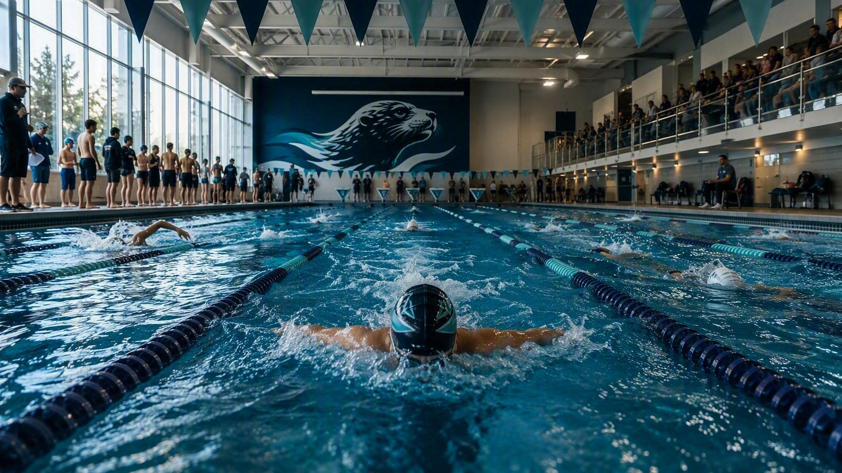


Introductory
Parents Night
2026–2027 SEASON
Welcome to the CWC Sea Lions
Notes:
[Sources]
Visual on this slide was generated with Microsoft Copilot.
[/Sources]

Slide 2
WELCOME
Tonight’s lane map
CLUB
COMMITTEE
COACHES
Who we are and who supports the season
Link to our Website is www.sealions.ca
Volunteering
Fundraising
Clothing & Equipment
Swim Meets
Social Events
Groups and coaches, dryland, training plans, meets and communication
Notes:
[Sources]
[/Sources]

Slide 3
COMMITTEE
Meet the 2025–2026 Sea Lions Committee
Chair
Vice Chair
Past Chair
Sam Lamontagne
Michelle Admiraal
Phil Chen
Treasurer
Secretary & Communications
Operations Committee
Rachel Widdifield
Jenine Mak
Michelle Chow • Sarah Williams • Aurora Young
Fundraising & Equipment Manager
Social Coordinator
Sara Stephenson • Danielle Mossfeldt
Tiana Demers
Notes:
[Sources]
2025 Sea Lions AGM.pptx (1).pdf, slides 17–18
[/Sources]

Slide 4
COACHING TEAM
Head Coach Robyn Lee and staff
Lead coaching staff
Alina (FUNdations, Fundamentals 1, Fundamentals 2, & Fundamentals 3)
Joel (Fundamentals 1, Fundamentals 2, & Fundamentals 3, & AGD Prep)
Elise (Age Group Development)
ROBYN LEE
HEAD COACH
Season leadership • group alignment • coach development
Assistant coaching staff
Jordan
Ian
Jesse
Notes:
[Sources]
2025 Sea Lions AGM.pptx (1).pdf, slide 5
[/Sources]

Slide 5
CALGARY WINTER CLUB
Director of Athletics: James Gattinger
Head of Aquatics: DJ Ulriksen
CWC UPDATES
AQUATICS UPDATES
COMMUNICATION
We have officially begun construction on Frame the Future, a major project focused on modernizing and enhancing Club facilities. During construction, parking and traffic flow will be impacted, so we kindly ask families to drop off and pick up athletes whenever possible to help reduce congestion. Please allow additional time when arriving at the Club and follow all posted parking and traffic directions. Team meetings will be held virtually during this period, and team banquets will be hosted at Silver Springs. We appreciate everyone’s patience and cooperation as we work through this exciting investment in the future of the Calgary Winter Club.
Our Aquatics facilities are also seeing several exciting improvements as part of Frame the Future. The main pool has received a new liner, including updated 15-metre markers on the pool bottom, along with new lane ropes to enhance our training environment. The Beach Pool will feature a new slide and an accessibility ramp, while re-tiling throughout the Aquatics areas and repairs to the hot tub will improve both appearance and functionality. Looking ahead, new Aquatics flags will be installed once the Calgary Winter Club’s new logo is released in early 2027. We’re excited about these updates and the continued improvements they will bring to our swimmers and families.
For all Sea Lions-related questions, concerns, or communication, families should come directly to Robyn, Head Coach. If additional support or input from DJ or James is needed, Robyn will connect with them and ensure the appropriate people are involved. For overall Aquatics-related matters, please contact DJ, and for overall Athletics & Recreation-related matters, please contact James. This communication structure will help ensure questions are directed to the right person and that information is communicated clearly and consistently to our families.
Notes:
[Sources]
2025 Sea Lions AGM.pptx (1).pdf, committee mandate and renovation context
Xerox Scan_20260828154026.PDF, pages 9 and 11
[/Sources]

Slide 6

OUR CLUB
A proud swimming tradition
Competitive development, community and learning at the Calgary Winter Club.
SINCE
DEVELOP
COMPETE
1961
Technique, fitness and confidence
Local, provincial and travel opportunities
Swimmers grow through disciplined training, competition and team connection.
Notes:
[Sources]
https://www.sealions.ca/pages/welcome
[/Sources]

Slide 7
SOCIAL COORDINATOR
Planned social events
Team connection happens beyond the lane lines. Dates and details will be posted as plans are finalized.
OCT
DEC
SPR
Halloween Movie
Christmas Party
Spring Movie
APR
SEASON
JUN
Fernie Lunch
Swim-a-thon
End-of-Year Party
Notes:
[Sources]
2025 Sea Lions AGM.pptx (1).pdf, slides 6–7
[/Sources]

Slide 8
OPERATIONS COMMITTEE
Volunteer requirements
Every family completes 4 credits during the season, regardless of the number of swimmers.
4 CREDITS
$150
$600
Required per family by season end
Charged for each outstanding credit
Full buyout option at the start of the season
Extra volunteer credits above the required four reduce the remaining fundraising requirement by $50 per credit.
Notes:
[Sources]
Xerox Scan_20260828154026.PDF, pages 8–10
[/Sources]

Slide 9
OPERATIONS COMMITTEE
Volunteer Credits and Training
Attend the mandatory parent meeting for 1 credit.
Officiating certification earns 2 credits after completing a clinic and the corresponding mentored meet shift.
A Level 1 officiating clinic is planned at the Calgary Winter Club in September 2026.
Free clinics may be available through the season for continued qualification upgrades.
Notes:
[Sources]
Xerox Scan_20260828154026.PDF, page 8
[/Sources]

Slide 10
OPERATIONS COMMITTEE
CWC hosted meets
Renovations change the venue, not the need to keep skills current.
The Sea Lions cannot host a meet at the Calgary Winter Club this season because of ongoing renovations.
Parents are required to volunteer at least one meet outside CWC.
The club will work with other clubs so officials and volunteers can maintain training and experience.
Eligible roles earn 1 or 2 credits depending on the position.
Notes:
[Sources]
Xerox Scan_20260828154026.PDF, page 9
[/Sources]

Slide 11



TEAM IDENTITY
Clothing and meet uniform
Order early, label everything and follow the coach’s event-specific expectations.
PRACTICE
MEETS
ORDERING
Training suit, cap, goggles and group equipment
Team swimsuit, team cap and designated club colours
Sizing information supports beginning-of-season stock planning
Clothing sales at https://www.trihub.ca/calgary-winter-club-sea-lions-storefront?currency=CAD
Password: CWC26
Notes:
[Sources]
Xerox Scan_20260828154026.PDF, pages 4–5
2025 Sea Lions AGM.pptx (1).pdf, slides 6–7
[/Sources]

Slide 12
FUNDRAISING
Family requirements
The 2026–2027 requirement is $250 per swimmer, to a maximum of $500 per family.
SEPT-OCT
OCT-NOV
FEB-MAR
Fill your freezer
Wreaths & holiday plants
Stay tuned!
Families that do not raise the required net profit are charged the difference after the final fundraiser.
Notes:
[Sources]
Xerox Scan_20260828154026.PDF, pages 11–12
[/Sources]

Slide 13
TREASURER
Where fundraiser money goes
Training equipment
Social and team-building activities
Trophies, awards and team photos
Coach gifts
Guest speakers and educational seminars
Coach travel to regional, national and championship meets
Scholarships
BOOSTER FUND
Fundraising +
meet revenue
invested back into athlete development and team connection
Notes:
[Sources]
Xerox Scan_20260828154026.PDF, page 11
2025 Sea Lions AGM.pptx (1).pdf, slides 9–16
[/Sources]

Slide 14
COACHING SEASON PLAN
A season built in phases
SEP–OCT
NOV–DEC
JAN–MAR
APR–JUN
Building a Foundation
Building on Race Pace
Refine & Perform
Build to Peak
Technical focus, building routines, aerobic base
Learning race pace, continuing to build aerobic and anaerobic base, early competition performance, maintaining technical focuses
Refining the details, race focused training into Winter Championship season for all athletes (March).
Team building, long-course focus, season finish.
Notes:
[Sources]
[/Sources]

Slide 15
SEASON TRAINING GROUPS
Practices by training group
Use the online calendar for the current pool and dryland schedule.
FUNdations
Fundamentals 1
Fundamentals 2
Coach: Alina
Coach: Joel/Alina
Coach: Joel/Alina
Fundamentals 3
AGD Prep
Age Group Development
Coach: Joel/Alina
Coach: Joel
Coach: Elise
Junior
Senior Prep
Senior
Coach: Robyn
Coach: Robyn
Coach: Robyn
Group Assistant Coaches: Coach Jordan, Coach Ian, and Coach Jesse
Confirm days, time and changes at www.sealions.ca/calendar
Notes:
[Sources]
https://www.sealions.ca/calendar
[/Sources]

Slide 16

SEASON DRYLAND
Practices by training group
Use the online calendar for the current pool and dryland schedule.
Senior, Senior Prep, and Junior will each have dryland twice a week. On Track 2 on Monday/Wednesday 6:00-7:00pm, and PT Studio on Friday 4:30-5:30pm.
AGD will have dryland once a week on Tuesday from 6:00-6:45pm on Track 2.
Dryland coaches are:
  Senior: Ben (Mon), Brendan & Fiona (Fri)
  SeniorPrep/Junior: Brendan (Wed), Brendan & Fiona (Fri)
  AGD: Martina (Tues)
Dryland training is an important part of our swimmers’ development, helping them build strength, power, mobility, coordination, and injury resilience that directly supports performance in the water.
Confirm days, time and changes at www.sealions.ca/calendar
Notes:
[Sources]
https://www.sealions.ca/calendar
[/Sources]

Slide 17
COACH COMMUNICATION
The right conversation at the right time
Keep communication respectful, athlete-centred and away from active practice or race moments.
PRACTICES
COMPETITIONS
DEVELOPMENT
We value open, respectful communication between parents and coaches. Please direct questions or concerns about practices, training, attendance, or progress to the coaching staff rather than addressing them on the pool deck or in front of athletes.
During practice: Please allow coaches to focus on the swimmers and avoid interruptions – no parents on deck!!!
Questions or concerns: Email the appropriate coach or arrange a private time to connect.
Athlete independence: We encourage swimmers to take increasing ownership of their training and communicate directly with coaches when appropriate.
Respectful communication: We expect communication to remain positive, respectful, and solution-focused.
Team updates: Schedule changes and important information will be shared through our regular communication channels.
Competitions are an important part of our swimmers’ development and provide an opportunity to put their training into practice. We ask parents to support their swimmer’s experience while allowing coaches to manage race plans, warm-ups, and competition logistics.
Attendance: Please communicate absences as early as possible.
At the meet: Coaches are responsible for athletes during scheduled team activities, including warm-up and racing.
Parent role: Encourage, support, and celebrate effort rather than focusing on times or results.
Communication: Please direct questions or concerns to coaches privately and not during the competition.
Independence: We encourage swimmers to take ownership of their schedule, equipment, races, and communication with coaches as they get older.
We want swimmers to take ownership of their development by working directly with their coach to set meaningful goals, identify areas for improvement, and take responsibility for their progress. Parents play an important role in supporting and encouraging this process, but goal setting and development should primarily be a conversation between the swimmer and coach, rather than something driven by parents.
Primary Head Coach / Registrar contact: robynl@calgarywinterclub.com
Notes:
[Sources]
Xerox Scan_20260828154026.PDF, pages 1 and 3
[/Sources]

Slide 18
SEASON SCHEDULE
Upcoming swim meets
Meet eligibility varies by group. Always use the event page and coach direction as the source of truth.
OCT 17
UCSC Fall Start Up (AGD, Junior, Senior Prep, & Senior)
OCT 17
Halloween Howler (Fundamentals 1, 2, & 3, Fundations, & AGD Prep)
NOV 14
Wacky T-Shirt (Fundamentals 1, 2, & 3, Fundations, &AGD Prep)
NOV 20–22
KSC Fall Invitational (AGD, Junior, Senior Prep, & Senior)
DEC 3–7
Christmas Cracker • Victoria Team Travel (Junior, Senior Prep, & Senior)
Dec 5–6
Jack Frost 2026 (All groups invited)
Notes:
[Sources]
https://www.sealions.ca/event/2026-2027-registration
[/Sources]

Slide 19
TEAM TRAVEL
Travel requirements
Team travel is a privilege supported by clear expectations and parent chaperones.
Head Coach determines eligibility and travel details for each competition.
Team travel is required — athletes stay with the team for all nights.
Athletes participate in team accommodation, meals, transportation, and activities throughout the trip.
Families are responsible for booking flights; swimmers must arrive and depart on the same day as the team flights.
If a swimmer chooses not to participate in full team travel, a different racing opportunity will be provided (if available).
Swimmers are expected to follow the CWC & Sea Lions Code of Conduct throughout travel, competitions, and camps.
Parent chaperones receive 4 volunteer credits for meets longer than two nights, and the family fundraising requirement is waived.
Families remain responsible for any consequences or costs if a swimmer's conduct requires them to return home early.
Notes:
[Sources]
Xerox Scan_20260828154026.PDF, pages 5–9
2025 Sea Lions AGM.pptx (1).pdf, slide 6
[/Sources]

Slide 20
SWIMMING READY
Practice & Competition Etiquette
TRAINING
DRYLAND
MEETS
Check the calendar for practice times, locations, and schedule changes.
Arrive on time and be ready to start at the scheduled time.
Training suit appropriate for practice – No bikinis or board shorts!
Goggles + spare pair
Cap + a spare
Water bottle
Group gear requirements as outlined by your coach.
Be ready on deck with all equipment prepared before practice begins.
Be respectful to coaches and follow instructions throughout the session.
Check the calendar for dryland times and locations.
Arrive on time and ready to participate.
Be ready in the gym with appropriate athletic clothing, footwear, and water.
Be respectful to coaches and follow instructions throughout the session.
Check the calendar for meet details, locations, and schedules – Notify coaches if your swimmer can no longer attend.
Arrive 10 minutes before the start of warm up and be ready to go.
If your swimmer is not present at the start of warm up, they will be scratched from all events (unless otherwise communicated)
Know your race times and stay aware of the meet schedule.
Training suit & competition suit*
Goggles + spare pair
CWC Sea Lions cap
Water bottle and Snacks
Towels
CWC clothing!!!
Deck activities for downtime
Be respectful to coaches, officials, teammates, and other competitors.
Notes:
[Sources]
[/Sources]

Slide 21
WEBSITE
Your parent home base
Sign in at sealions.ca to access team-specific event actions and information.
sealions.ca
Calendar • Events • Declarations • Jobs • Parent information
Bookmark the site and check it weekly, then again before every meet or volunteer shift.
Notes:
[Sources]
https://www.sealions.ca/
[/Sources]

Slide 22
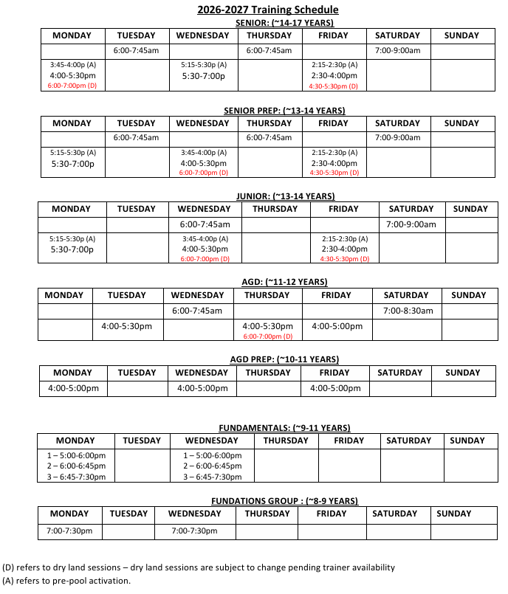
WEBSITE
Find schedules
Use the calendar filters to see the schedule for the swimmer’s registered group.
Open the Calendar page.
Select the relevant group calendar, such as FUNdations, AGD, Junior, or Senior.
Review practice and event details regularly for changes.
Treat the current online calendar as the source of truth.
Notes:
[Sources]
https://www.sealions.ca/calendar
[/Sources]

Slide 23
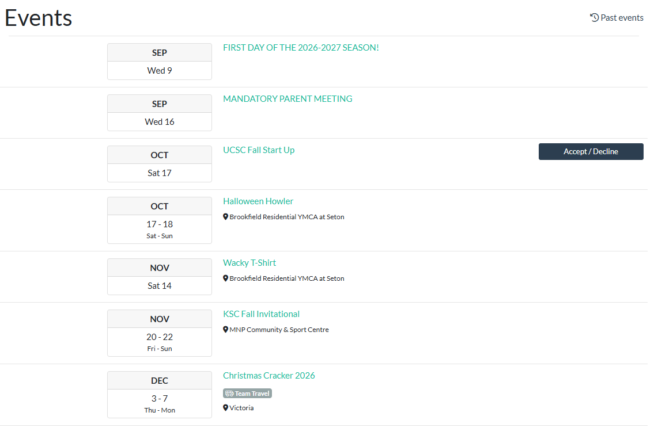
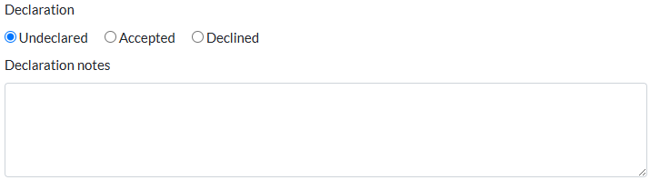
WEBSITE
Declare your swimmer for meets
Declarations help coaches finalize meet entries by the posted deadline.
Sign in to the primary parent account.
Open the applicable event from the Events page.
Review eligibility, meet information and the declaration deadline.
Select Accept or Decline for the swimmer before the deadline.
Check that the declaration is saved and review later updates.
Look back here to see which events your swimmer is register for.
Unregistered swimmers at the declaration deadline will be assumed to not be attending the meet.
Notes:
[Sources]
https://www.sealions.ca/event/2026-2027-registration
[/Sources]

Slide 24
WEBSITE
Sign up for volunteer events
Sign in and open the applicable event.
Select the Jobs or volunteer sign-up area when available.
Choose a role that matches current training or mentorship needs.
Note the shift time and arrive for the event briefing.
Track credits through the season and retain confirmation of completed roles.
Notes:
[Sources]
https://www.sealions.ca/event/2026-2027-registration
Xerox Scan_20260828154026.PDF, pages 8–9
[/Sources]

Slide 25

PARENT BENEFIT
Tri Hub Card
Use the Sea Lions Card for Tri Hub discounts in store. The CWC/Tri Hub parent website pricing already has the discounts applied.
How to use it
TRI HUB
CARD
Find the Tri Hub Card discount card information in the parent area of the Sea Lions website. Review the current discount details and present the required card or code when purchasing eligible items.
Tri Hub team discount card in store
Notes:
[Sources]
User-provided requirement; confirm current discount terms on the parent website.
[/Sources]

Slide 26

MEET DAY TOOL
Meet Mobile app
Follow published meet information and results from a phone.
FIND
FOLLOW
REMEMBER
Download the app and pay for the yearly subscription.
Search for the meet by name or location.
Family sharing of the app is available – often older swimmers use the app to track times and events.
View events, heats, lanes, times and published results
The app is informational; coach and official direction takes priority
Availability and timing of information depend on the host meet publishing data.
Notes:
[Sources]
Meet Manager Procedure email and Fundamentals Technical Bulletin email; Meet Mobile referenced as available once meet data is published.
[/Sources]

Slide 27
TEAM STANDARDS
Code of conduct
Every member is an ambassador for the Sea Lions, CWC and competitive swimming.
Be courteous, punctual and helpful.
Treat coaches, athletes, parents and competitors with dignity and respect.
Follow CWC and Sea Lions rules at practices, meets, camps and social events.
Wear the team uniform when required.
Do not post images or social media content involving teammates, coaches or CWC members without permission.
The Code of Conduct was signed by each swimmer and parent with the registration package.
The website has a copy of the Code of Conduct for review.
Notes:
[Sources]
Xerox Scan_20260828154026.PDF, pages 4–7
[/Sources]

Slide 28
START STRONG
Your first-week checklist
Complete the basics now so the season can quickly settle into a routine.
✓
Confirm website sign-in
✓
Check the group calendar
✓
Save coach contact details
✓
Label all equipment
✓
Review volunteer credits
✓
Note fundraiser commitments
✓
Learn how to declare for eligible meets
✓
Read the Code of Conduct
Notes:
[Sources]
[/Sources]

Slide 29
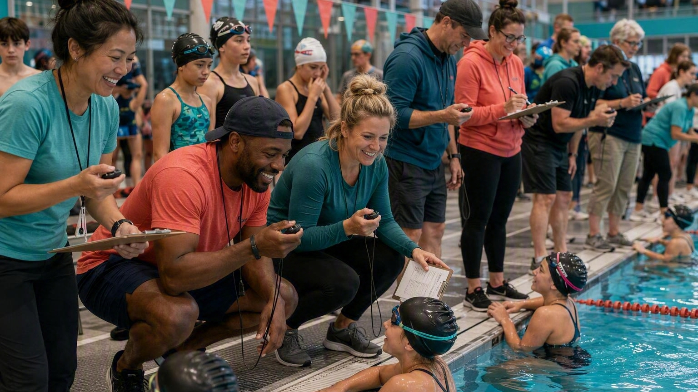
Any questions?
Thank you for supporting the CWC Sea Lions.
www.sealions.ca
Notes:
[Sources]
Visual on this slide was generated with Microsoft Copilot.
https://www.sealions.ca/
[/Sources]

