Slide 1
Introduction to swimming Officiating
October 28, 2025

Slide 2
Officiating is a win-win scenario. Competitions run on the backs of the Officials, and the pool deck is the best seat in the house to observe all swimmers including your own. It also counts towards mandatory volunteer points requirement each year.
The key person in the Club to connect with is the Chair of Officials or Director of Competitions-Romy Aquino at DCSC. The Provincial Chair of Officials is Kelley Polley. Her email is: Kelley@polycorp.co
Registration with Swimming Canada/Swim NS is mandatory every year to ensure that all adults dealing with swimmers (minors) are qualified and identifiable in case any issue arises at a given swim meet.
First time registrants will set up their profile with Swimming Canada/REMS and in subsequent years, registration will only require renewal or confirmation that the data in your profile is up to date.

Slide 3
Once registered, you gain access to Swimming Canada’s Learning Management System (LMS) which allows you to take the basic Online Clinics to become a Timer/Safety Marshall which is also known as a Level 1 Official.
There are 2 Mandatory Clinics, and each takes 45 minutes to complete.
There are 3 other clinics you may take Online: Chief Timer, Administration Desk and Canadian Para Swimming clinic.
After completion of the first two above, you are qualified to be a Timer at any meet.
https://swimming.canada.sportsmanager.ie/sportlomo/users/login

Slide 4
1. Before You Begin
• You must be registered as an official for the current swim season through your club and approved in the
Swimming Canada Registration, Events & Membership System (REMS).
• Ensure you know your REMS username and password. These are also used to log into the LMS.
2. How to Access the LMS
• Go to the Swimming Canada website:
https://swimming.canada.sportsmanager.ie/sportlomo/users/login
• Log into REMS with your username and password.
• Open your Member Card (click your name in the top right, then “My Profile”).
• Select “Login to LMS” → choose Official.

Slide 5
3. Navigating the LMS
Once inside the LMS, you’ll see a dashboard with tabs:
• Status – your current certification level and progress.
• eLearning Modules – online learning courses you can complete anytime.
• Clinics – schedule and register for upcoming virtual or in-person clinics.
• Resources – download manuals, rule books, and guides.
• Profile – update your personal information.
4. Registering for Clinics
Click the Clinics tab:
• Browse the list of available clinics.
• Select Register next to the clinic you wish to attend.
• Confirm details (date, time, format).
• You’ll receive confirmation and instructions by email.

Slide 6
There is a certification pathway on Swimming Canada from Level 1-5.
Depending on your skill set or desire to be on deck or behind the scenes as an Official, there are other clinics such available Online or through Zoom.
Swim NS will have bi-annual (Fall and Spring) Mass Clinics arranged for all Officiating Roles and you can decide to attend as many or all of them to learn the requirements/skills necessary for that role.
These Clinics include Chief Timer, Inspector of Turns, Judge of Stroke, CJE, Meet Manager, Starter, Chief Recorder and Referee.

Slide 7
Chief Timer-Carries 2 watches and supports the timers. Does the Pre-Meet briefing.
Starter-The Official who starts each heat and often does the Safety Marshall role as well.
Inspector of Turns-The official at either end of the pool who observes the swimmers touches and turns either at the Start End or the Turn End of the pool.
Stroke Judge-The Official who walks with the swimmers and observes the stroke throughout the race.
CJE-Chief Judge Electronics-The Official who operates the computer at pools like Dalplex where there are touch pads for electronic timing.

Slide 8
Chief Recorder-The Official who inputs the manual (watch) times into a program and generates the results of all heats/events.
Meet Manager- Organizes the entire meet and is responsible for Pre-meet, In-meet and Post-meet duties.
Session Referee-The Head Official for each session of a given meet. Can be the same person as the Head Official for the entire meet for different.

Slide 9
Inspector of Turns Course:
Tuesday November 4th – 6:30pm until approx. 8:30pm
Clinic Instructor – Paul Melanson
Prerequisite: Introduction to Swimming Officiating (the Timer’s Course)
Starter Clinic:
Wednesday November 5th - 6:30pm until approx. 8:30pm
Clinic Instructor – Bronwyn Duffy
Prerequisite: Introduction to Swimming Officiating (the Timer’s Course) and Inspector of Turns Course
Meet Managers Course:
Thursday November 6th – 6:30pm until approx. 8:30pm
Clinic Instructor – Nicole Humble
Prerequisite: Introduction to Swimming Officiating (the Timer’s Course)

Slide 10
Stroke Clinic:
Wednesday November 12th - 6:30pm until approx. 8:30pm
Clinic Instructor – Kelley Polley
Prerequisite: Introduction to Swimming Officiating (the Timer’s Course) and Inspector of Turns Course
Chief Recorder Clinic:
Thursday November 13th - 7pm until approx. 8:30pm
Clinic Instructor – Beth Casey
Prerequisite: Introduction to Swimming Officiating (the Timer’s Course)

Slide 11
5. Completing eLearning Modules
Go to the eLearning Modules tab:
• Choose the course you need (e.g., Introduction to Swimming Officiating).
• Click Enroll to start.
• Follow the narrated slides / activities.
• Complete the quiz at the end (if applicable).
• Your results will automatically update in the officials’ database.
6. Support
• Forgot your REMS password? Use the “Forgot Password” link on the REMS login page.
• Technical issues with LMS? Contact your Club Officials Administrator (COA) OR swimming@sportnovascotia.ca
• Missing credentials ? → Contact your Club Officials Administrator (COA) OR
swimming@sportnovascotia.ca
Tip: Keep a record of the clinics and modules you’ve completed. Your progress will appear in REMS, but having your own notes can help when applying for meets or higher certification.

Slide 12
The Chair of Officials and/or coaches will forward all information relating to upcoming Officials Clinics, upcoming Swim Meets and volunteer opportunities. This information comes from Swim NS to all clubs and coaches.
Each Meet has a Head Official/Meet Referee who is responsible to assign the officiating roles for that meet.
The name of the Head Official and contact email will be shared with the Meet Information so individuals can contact the Head Official with their availability and position preference.
The information about each meet is also available on the Swim NS website and the meet package information will be available on the Swimming Canada website going forward.

Slide 13
The Head Official puts together a Document known as the Assignment of Officials. This is the permanent record of which Officials were on deck and in what capacity at every meet. It is also used by clubs to track volunteer points.
Here is an example from the Distance Meet held last year

Slide 14
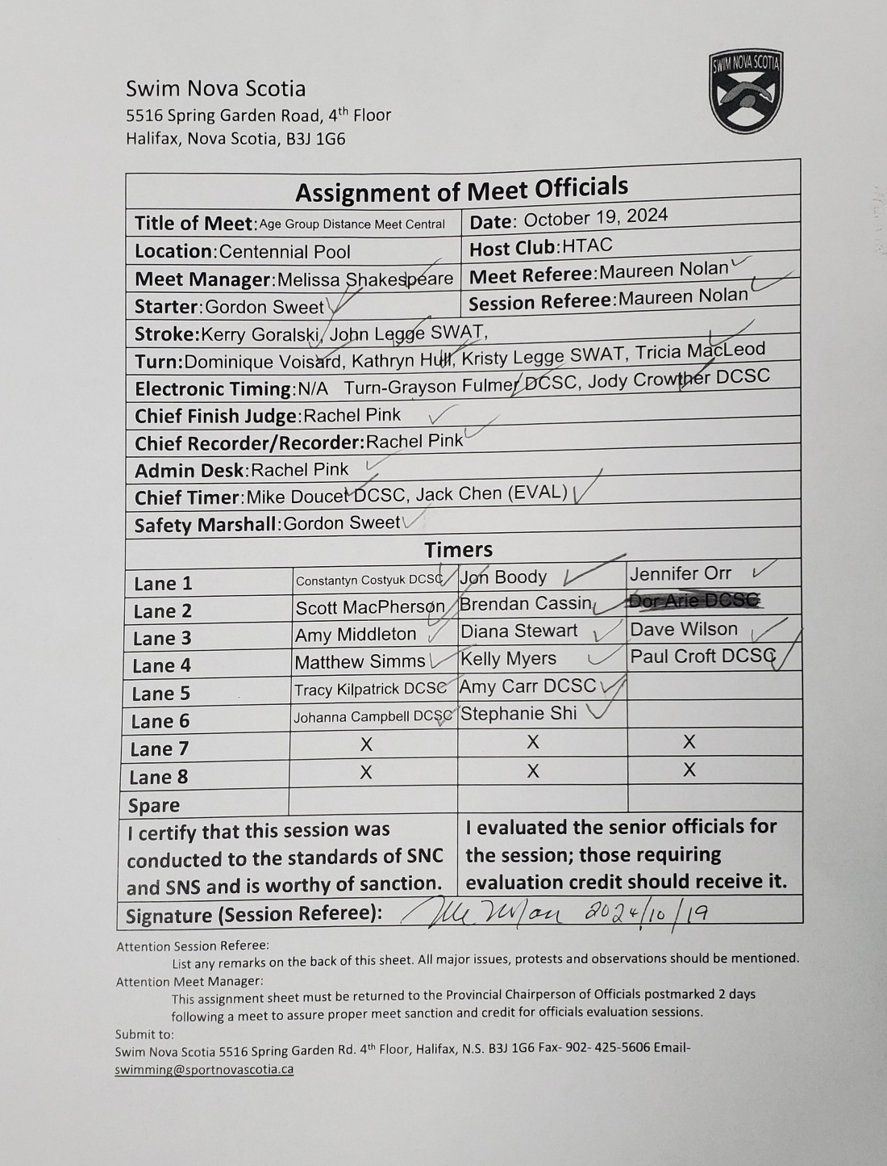

Slide 15
Officials are required for all meets and thus are crucial to your swimmers.
Getting involved does mean a time commitment, but it also means you are contributing to the success of each meet especially the ones hosted by DCSC.
When DCSC is responsible for hosting a meet, that means the club must provide the bulk of the officials, support staff, hospitality etc.

Slide 16
DCSC is hosting 2 meets this year: AA + Nova tech Meet on January 24-25, 2026, at Centennial, AAA/AA LCM April25-26, 2026, at Centennial Pool PLUS 6 MINI MEETS at Zatzman Sportsplex for the Participation Level Swimmers on Saturday Mornings. First one Nov 1, 2025.
The Schedule of all Swim NS meets is on the Swim NS website under the events tab. It lists every meet for the entire year, who is hosting it and where it is being held
There will be emails from the Club prior to each meet asking for volunteers including Officials especially for the DCSC hosted meets.
Time commitment depends on the position you volunteer for and the type of meet (Nova Tech versus Age Group) but can range from 3-5 hours per session.

Slide 17
Nova Tech meets are usually 1 session whereas Age Group meets can be 2-6 sessions depending on whether it is a regular meet or a championship (multi-day) meet.
You are not required to commit to multiple sessions for a given meet (although you can) however you are required to commit for the entire session you sign up for.
Attire for Officials for regular meets is White top, black bottoms, and appropriate deck footwear. Be prepared to get a bit wet!
Certain meets have a different requirement for finals (a red top) for Senior Official (everyone EXCEPT for Timers) but this will be communicated in advance, so Officials are aware what the dress code is. Timers wear white tops at all meets regardless of the type of meet.

Slide 18
I am available to support the club as a Level 5 Official.
My email address is: memejejedede@gmail.com
Feel free to reach out if you have any questions or wish to have a clinic taught at DCSC. I can arrange for that to happen either over Zoom or in person depending on your preference and availability.

Slide 19
QUESTIONS?

