Slide 1

SWAT 101 Information for Parents
September & October 2025

Slide 2
Groups vs Competitions
SWAT Training Groups
Mini Waves
Tidal Waves
Novice
Junior P/A
Senior P
Senior A
Senior N
SNS/SNC Competition Groups
NovaTech
Age Group
National Level
**Note that achieving graduation time standards does not necessarily mean your swimmer will move training groups.

Slide 3
Swim Meets
NovaTech (Mini Waves, Tidal Waves and Novice Groups)
Participation
Level 1
Level 2
Age Group (Novice, Junior and Seniors)
AA
AAA
**Swimming over March Break for Juniors and Seniors due to important meets
National (Senior)
Canadian Junior Trials
Canadian Swimming SC Championships

Slide 4

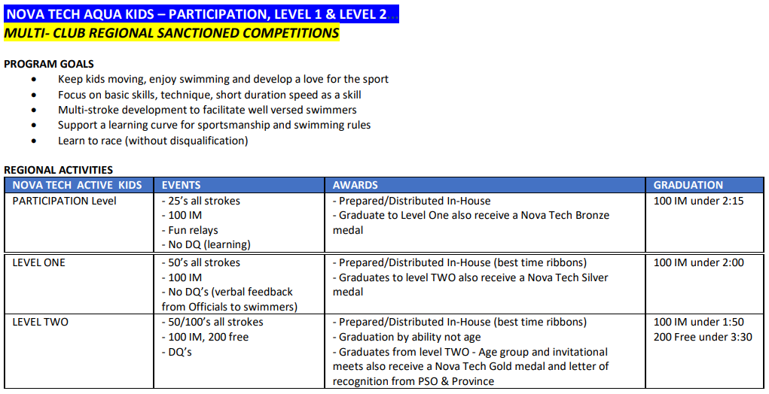
NovaTech Competitions (Central)

Slide 5
Age Group – AA and AAA
Must graduate from the NovaTech (NT) program before swimming in Age Group swim meets
Competitions are around the province, by age and gender
Season is combined in Age Group (AA and AAA) from September through December
In January, season splits between AA and AAA
AA swim meets are in 25m pools (SCM – short course meters)
AAA will race in 50m pools (LCM – long course meters)
**MEET FEES ARE PAID BY SWAT**

Slide 6
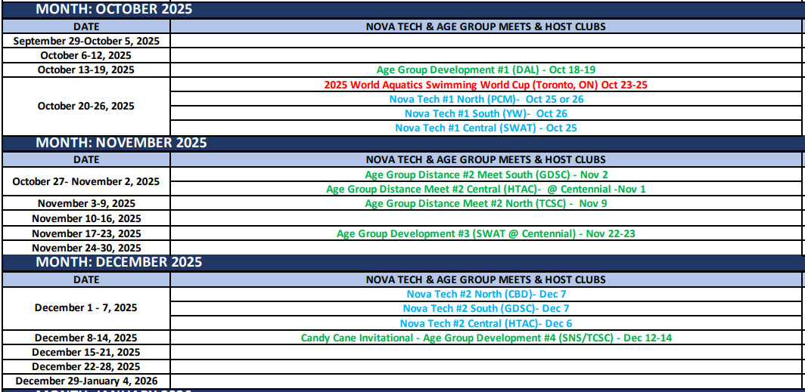

Slide 7
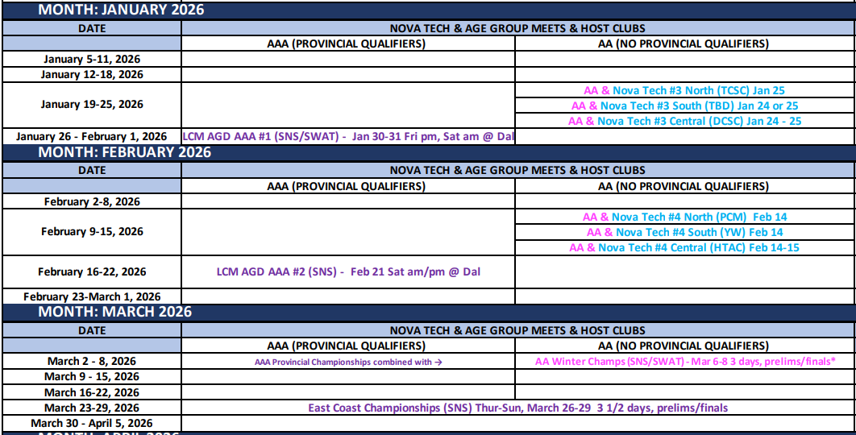

Slide 8
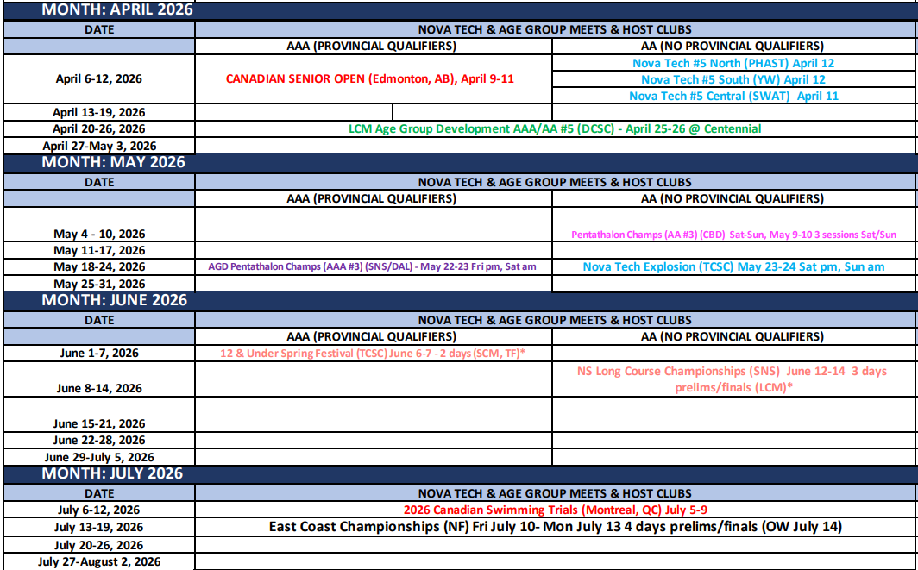

Slide 9
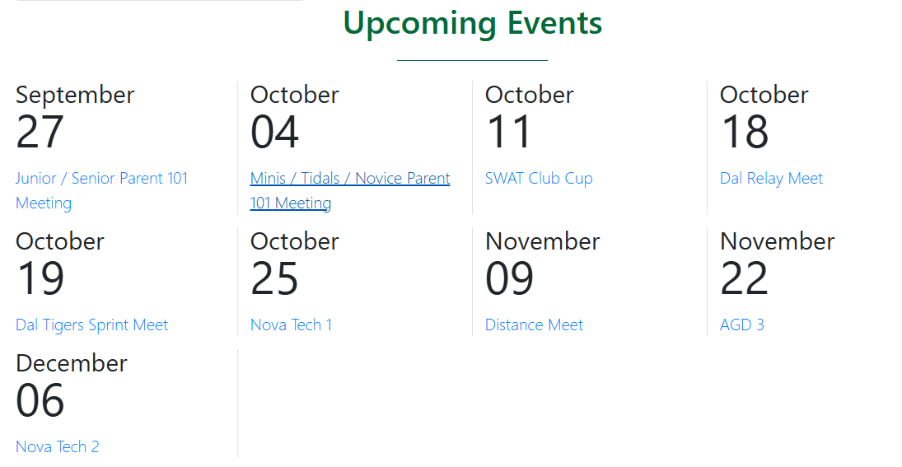
PoolQ (SWAT webpage)
To sign up for swim meets, events and volunteering for SWAT hosted swim meets navigate to the Upcoming Events section on the Home Page

Slide 10
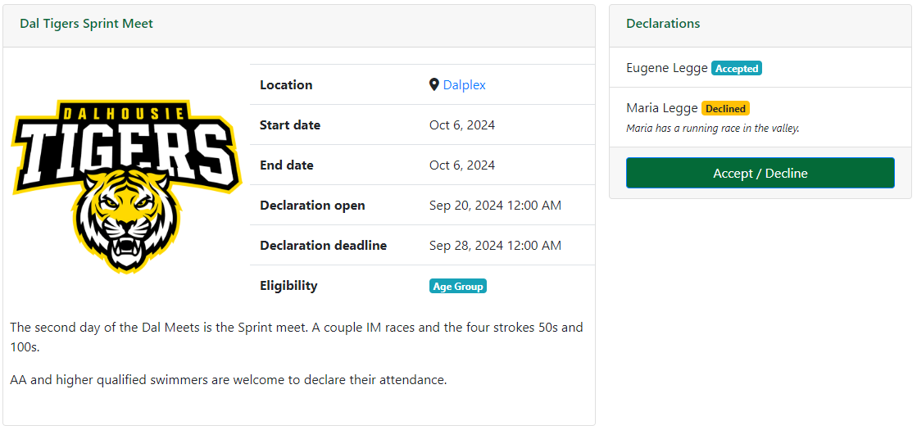

Slide 11
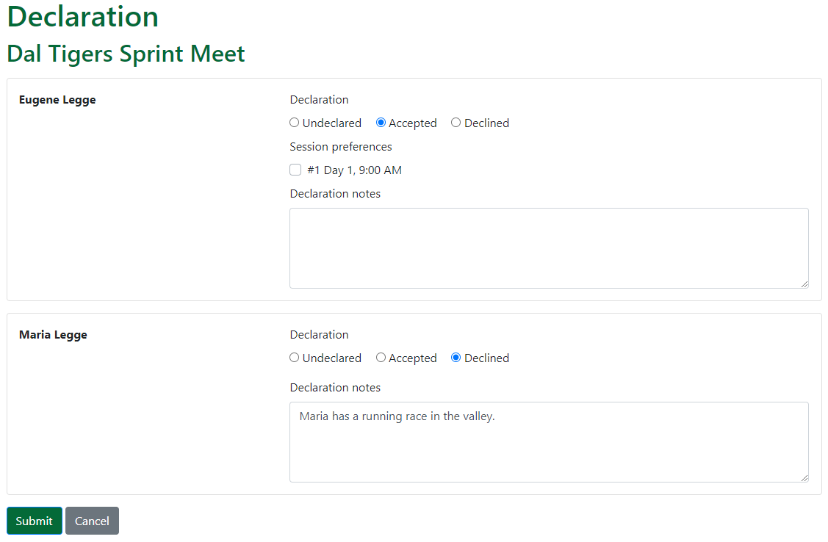

Slide 12
Important links
Swim Nova Scotia https://www.swimnovascotia.com/events
Schedule of events (can get updated throughout the season)
Lots of program information
Qualifying time standards
SWAT https://swat.poolq.net/
Parent Facebook group: SWAT Family Forum
Swim Canada https://www.swimming.ca/en/events-results/live-upcoming-meets/

Slide 13
Fundraising Commitment
Group Name | First Child | Second Child
Senior National | $300.00 | $240.00
Senior Atlantic | $300.00 | $240.00
Senior Provincial | $250.00 | $200.00
Junior Atlantic | $250.00 | $200.00
Junior Provincial | $250.00 | $200.00
Novice | $200.00 | $160.00
Tidal Waves | $150.00 | $120.00
Mini Waves | $100.00 | $80.00

Slide 14
Fundraising Plans
Gift Card Basket Raffle:
November - $25 covered by SWAT
March - $25 covered by SWAT; draw date March 8 at AA/AAA Provincial Champs
Commitment is each swimmer to sell 50 tickets @ $1 each for each raffle
Brad Marchand Signed Florida Panthers Jersey
Commitment is each swimmer to sell 20 tickets over the season at $5
Swim-a-thon
April (to be confirmed with Coach Matt)
50/50 Raffle: Seniors Traveling to Windsor, ON in May

Slide 15
Corporate Sponsorships
SWAT is hosting a championship swim meet in March 2026
We are looking for contacts for potential sponsors for the AAA Championship swim meet being held at Dalplex.
The Ask: $1000 to sponsor a swim event (there are 20 events)
In Return:
Advertising at this 3-day swim meet near the spectator entrance and canteen
Advertising in the swim meet program
Announcement during finals for the sponsor
Advertising on our SWAT webpage
Please contact Darren Hiltz at darrenhiltz@yahoo.ca

Slide 16

Volunteering
Officiating
On deck volunteering
Training/Teaching
SWAT Board - Open positions
Cost Recovery Chair
Webmaster
Fundraising Committee Members (4)
SWAT Events and other ways to help
Special Events (Christmas)
Team Socials
Banquet

Slide 17
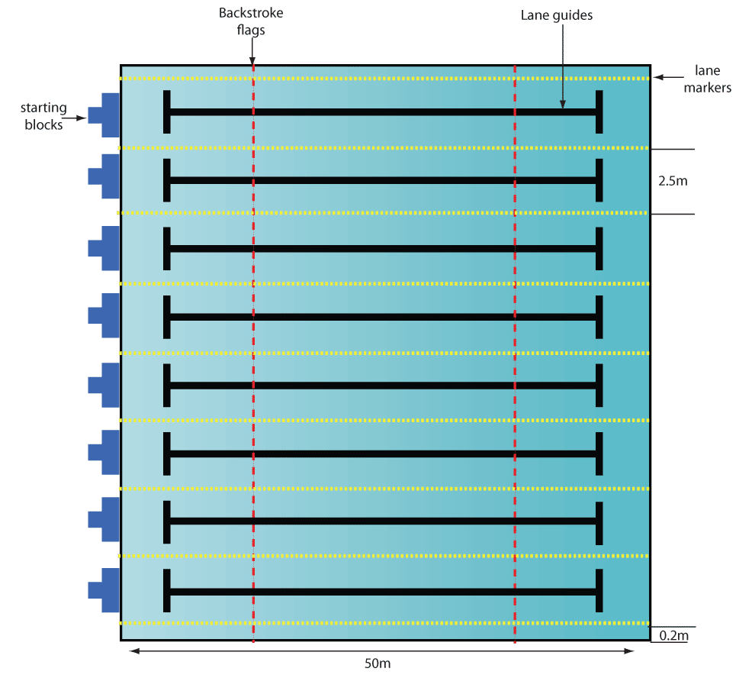
Officiating
Each swim meet requires a minimum of:
16 Timers (2 per lane)
2 Chief timers
6 Turn judges (1 per 2 lanes is better)
2 Stroke judges
1 Starter
1 Referee (2 for championship meets)
1 Electronics judge or Chief finish judge
1 Recorder scorer
1 Meet manager + Hospitality assistance
**Over 30 volunteers for each session!

Slide 18
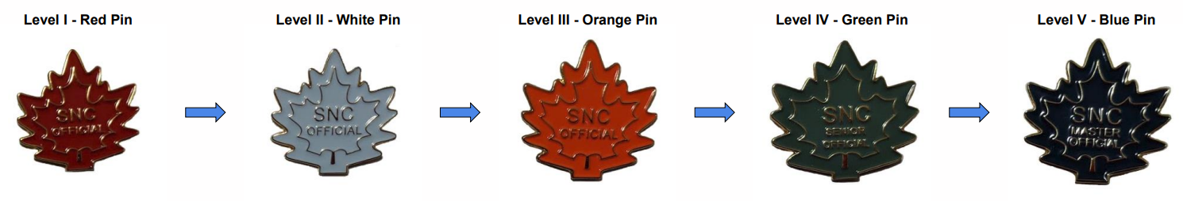
Officials Training
Level I – Red Pin
Level II – White Pin
Level III – Orange Pin
Level IV – Green Pin
Level V – Blue Pin
*Full information on the Officials Certification Pathway can be found here: https://www.swimming.ca/wp-content/uploads/2024/08/Officials-Certification-Pathway-September-2023.pdf

Slide 19
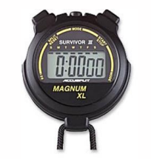
Level I – Red Pin
Complete the Introduction to Swimming Officiating clinic
Complete the Safety Marshal clinic
Complete registration in the Swimming Canada Officials Registration System

Slide 20
Level II – White Pin
Certify in Level I by obtaining 2 successful deck evaluations as a Timekeeper
Complete the Judge of Stroke clinic AND Inspector of Turns clinic and obtain 2 successful deck evaluations (1 as Stroke and 2 as Turn)
Complete one other Level II clinic and obtain 2 successful deck evaluations
Chief Timekeeper
Clerk of Course
Chief Finish Judge (CFJ) / Chief Judge Electronics (CJE)
Meet Manager
Starter

Slide 21
SWAT Volunteer Requirements
Group Name | First Child | Second Child
Senior National | $500.00 | $400.00
Senior Atlantic | $500.00 | $400.00
Senior Provincial | $500.00 | $400.00
Junior Atlantic | $400.00 | $320.00
Junior Provincial | $400.00 | $320.00
Novice | $300.00 | $240.00
Tidal Waves | $200.00 | $160.00
Mini Waves | $200.00 | $160.00

Slide 22
How to obtain volunteer points
Volunteer on the Board
Some positions cover the entire family's commitment for the season
Volunteer as an Official
Timer – 1 session = $50
All other roles – 1 session = $100
Complete an Officials clinics
Varies depending on level of clinic
More information on ways to obtain points:
https://blob.poolq.net/swat/files/swat-volunteer-requirement-policy-july-2025.pdf

Slide 23
SWAT Hosted Meets
Important dates for volunteering:
Oct 25th: NT#1 Central – Centennial pool (1 session), afternoon
Nov 22/23: AGD #3 – Centennial pool (3 sessions)
Jan 30/31: LCM AGD AAA #1– Dalplex pool (2 sessions)
Mar 6-8: LCM Prov Champs(AA/AAA) – Dalplex pool (6 sessions)**
Apr 11th: NT #5 Central – Centennial pool (1 session), afternoon
**This meet is an ALL HANDS ON DECK request. Please commit to 2 sessions if at all possible. Whether you have swimmers attending or not.

Slide 24
How to report your volunteer points
If you volunteer at swim meets or take officials courses, you will need to report your points to our SWAT Points Coordinator.
All you need to do is email Gabriel at volunteerpoints@swatswim.ca and include the following information:
For swim meets:
Full name, your Officials level and number of sessions
For courses:
Full name, course name and level
**Please email right after the meet/course is completed

Slide 25
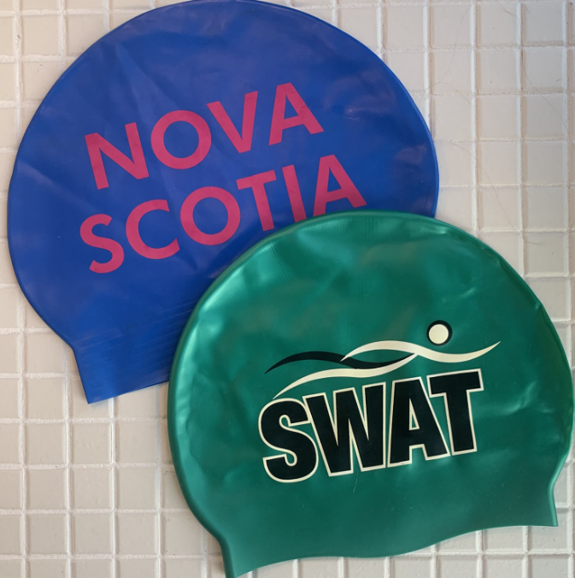
Equipment
Mini Waves:
Training suit (one piece for girls, jammer or brief for boys)
Swim Cap (one included in registration each year)
Goggles
Water bottle
Junior sized kick board (optional)

Slide 26
Equipment
Tidal Waves:
Training suit (one piece for girls, jammer or brief for boys
Swim Cap (one included in registration each year)
Goggles
Water bottle
Junior sized kick board
Short swim fins

Slide 27
Equipment
Novice
Training suit (one piece for girls, jammer or brief for boys)
Swim Cap (one included in registration each year)
Goggles
Water bottle
Junior sized kick board
Short swim fins
Swim snorkel

Slide 28

Questions?

