Slide 1

SWAT 101
Information for Parents
October 2026

Slide 2
Groups vs Competitions
SWAT Training Groups
  Mini Waves
  Tidal Waves
  Novice
  Junior P/A
  Senior P
  Senior A
  Sr & Para N
SNS/SNC Competition Groups
  NovaTech (NT)
  Age Group (AA/AAA)
  National Level
**Note that achieving graduation time standards does not necessarily mean your swimmer will move training groups.

Slide 3
Swim Meets
NovaTech (Mini Waves, Tidal Waves)
  Participation (in house/during practice)
  Level 1
  Level 2
Age Group (Novice, Junior, Senior and Para)
  AA
  AAA
National (Senior & Para)
  Canadian Junior Trials
  Canadian Swimming SC Championships

Slide 4

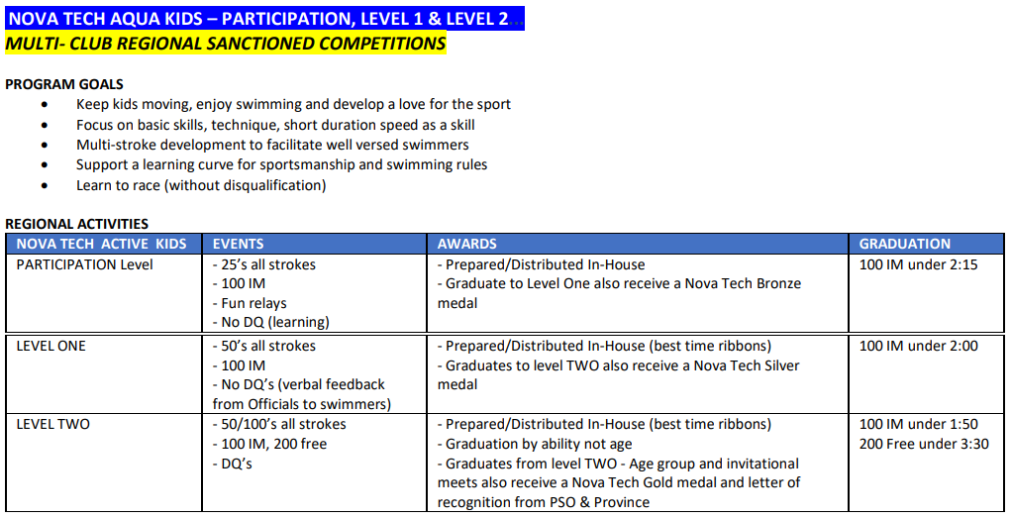
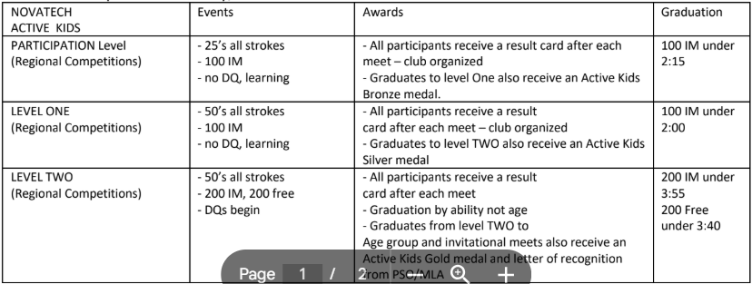
NovaTech Competitions (Central)

Slide 5
Swim Meets
Must graduate from the NovaTech (NT) program before swimming in Age Group swim meets
NT meets are regional and held in HRM with the exception of the NT Explosion in May, held in Truro (2 sessions Sat PM/Sun AM)
Some NT and Age Group (AG aka AA/AAA) meets are held over the same weekend and are regional
Some AG meets are all of NS (AGD #1, AGD #3) are short course meters (SCM = 25m pool) and long course meters (LCM = 50m pools)
**SNS SCHEDULE MEET FEES ARE PAID BY SWAT**

Slide 6
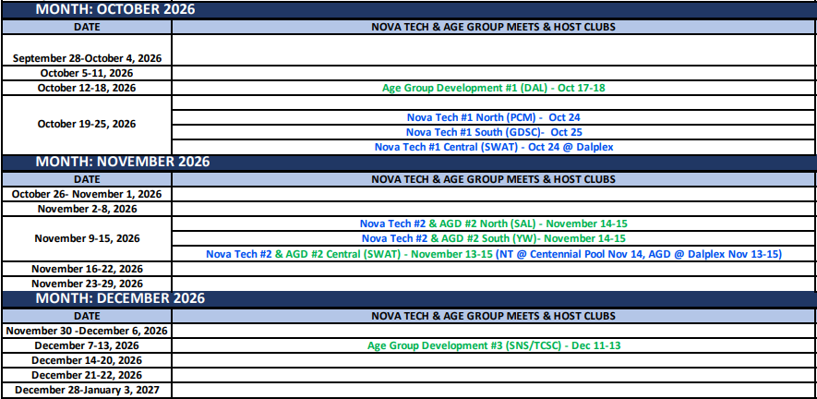

Slide 7
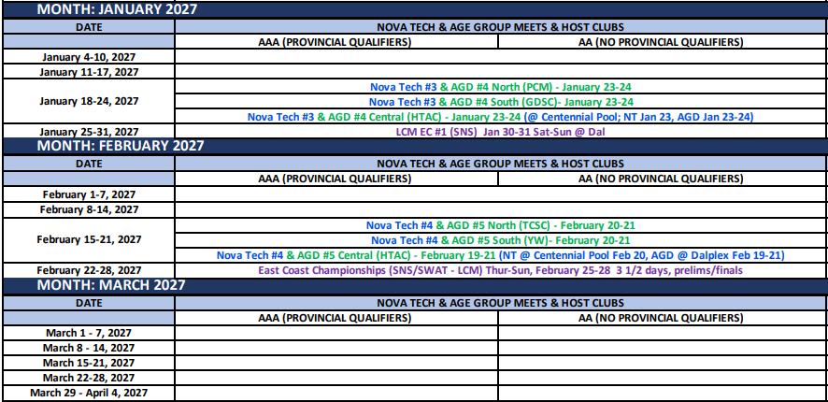

Slide 8
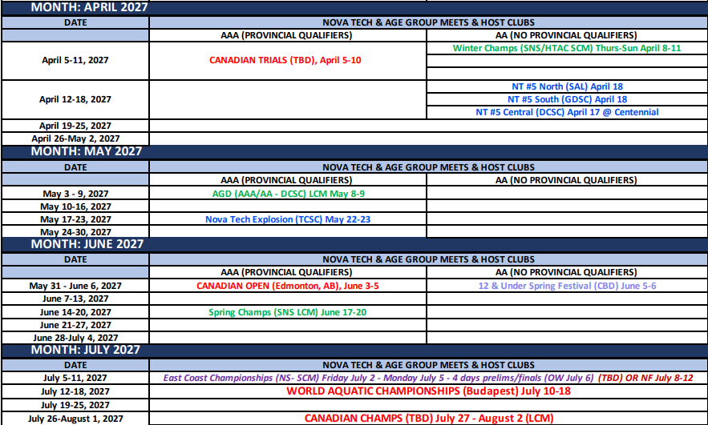

Slide 9
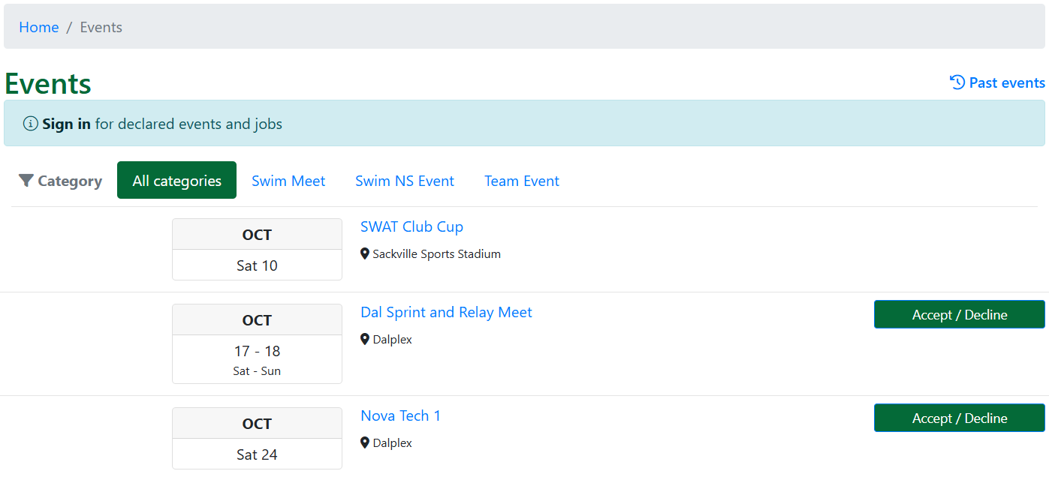
PoolQ (SWAT webpage)
To sign up for swim meets, events and volunteering for SWAT hosted swim meets navigate to the Upcoming Events section on the Home Page.
*You must be logged in to your account to declare. https://swat.poolq.net/

Slide 10
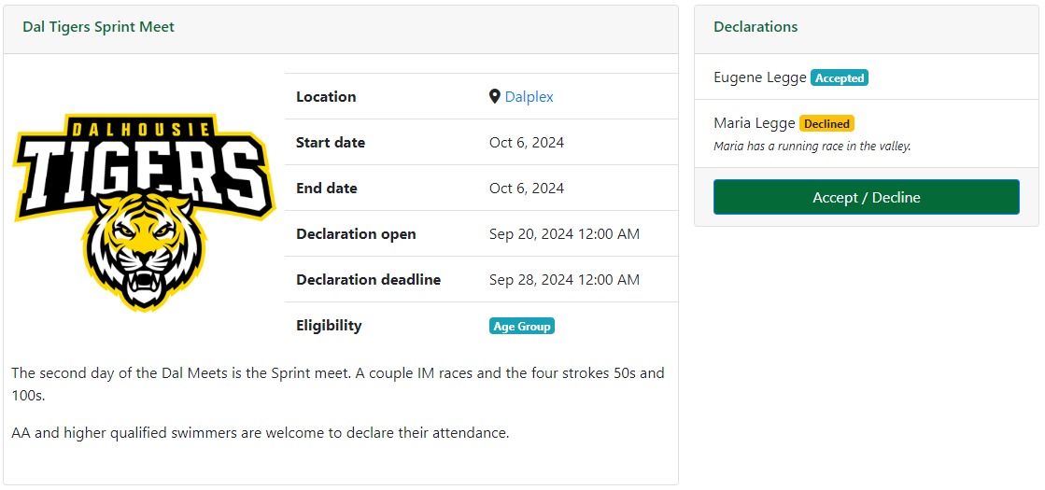

Slide 11
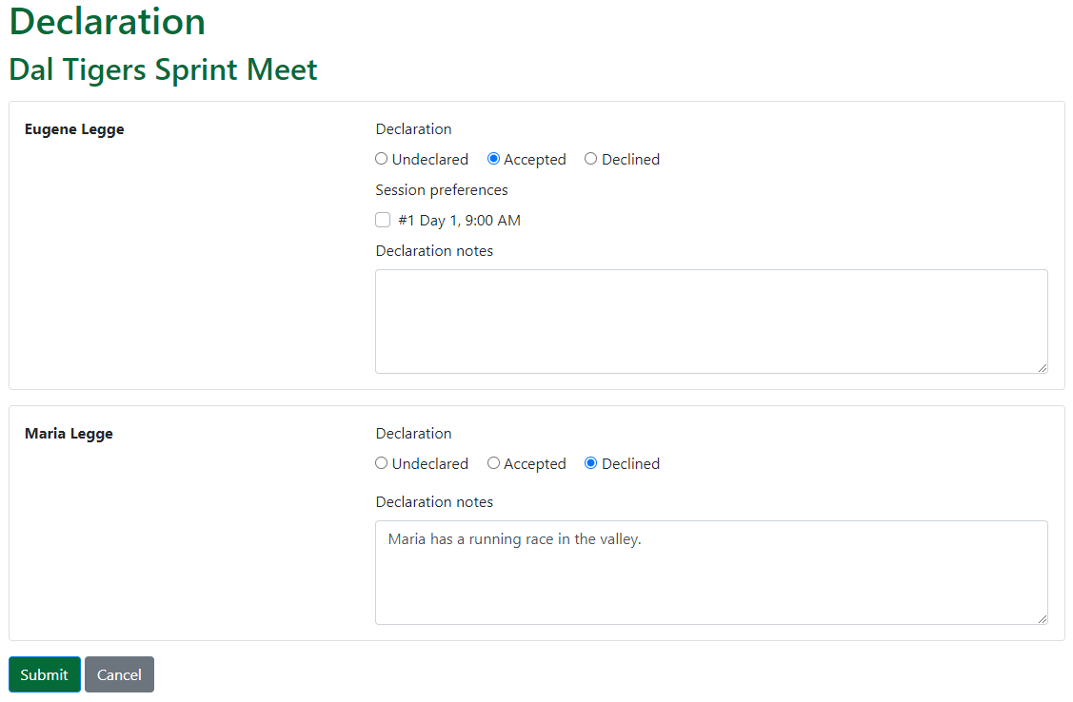

Slide 12
Important links
Swim Nova Scotia https://www.swimnovascotia.com/events
  Schedule of events (can get updated throughout the season)
  Lots of program information
  Qualifying time standards
SWAT https://swat.poolq.net/
Parent Facebook group: SWAT Family Forum
Swim Canada https://www.swimming.ca/en/events-results/live-upcoming-meets/

Slide 13
Fundraising Commitment
Group Name | First Child | Second Child
Sr National & Atlantic | $300.00 | $240.00
Sr Prov. & Dev. | $250.00 | $200.00
Junior | $250.00 | $200.00
Novice | $200.00 | $160.00
Tidal Waves | $150.00 | $120.00
Mini Waves | $100.00 | $80.00
Para | $250.00 | $200.00
**If commitment is not met during the season, payment will be pulled in July/August

Slide 14
Fundraising Plans
Gift Card Basket Raffle:
  December draw - $2000; $1000 grocery (Sobeys) & $1000 gas (Shell)
  Commitment ask is each swimmer to sell 50 tickets @ $1 each
Swim-a-thon
  March 27th date set
  For all SWAT members, each group has a goal to achieve in the time allocated
  Watch for information to be circulated on setting up your fundraising page

Slide 15
Corporate Sponsorships
SWAT is hosting the East Coast Championships swim meet in February 2027
We are looking for contacts for potential sponsors/supporters for SWAT this season.
Three Tiers:
Gold ($1000)
Silver ($500)
Bronze ($250)
See Corporate Sponsorship package with details
Please contact Darren Hiltz at darrenhiltz@yahoo.ca
Or contact Kristy Legge at kristylegge@swatswim.ca

Slide 16

Volunteering
Officiating
  On deck volunteering
  Training/Teaching
SWAT Board - Open positions
  VP Finance
  Fundraising Chair
  Recruitment Chair
SWAT Non-Board - Open positions
  Fundraising Committee Members (4)
  Canteen Coordinator
SWAT Events and other ways to help
  Special Events (Christmas)
  Team Socials
  Banquet

Slide 17
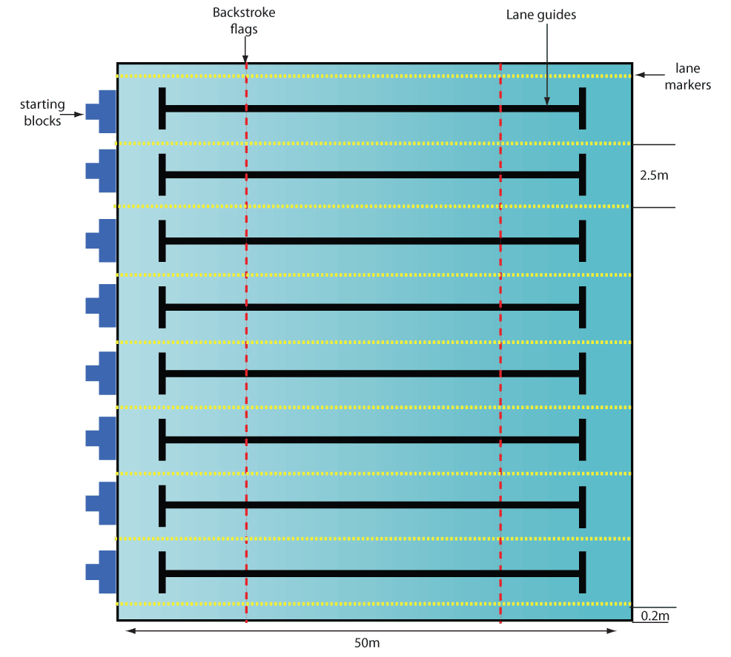
Officiating
Each swim meet requires a minimum of:
  16 Timers (2 per lane)
  2 Chief timers
  6 Turn judges (1 per 2 lanes is better)
  2 Stroke judges
  1 Starter
  1 Referee (2 for championship meets)
  1 Electronics judge or Chief finish judge
  1 Recorder scorer
  1 Meet manager + Hospitality assistance
**Over 30 volunteers for each session!

Slide 18
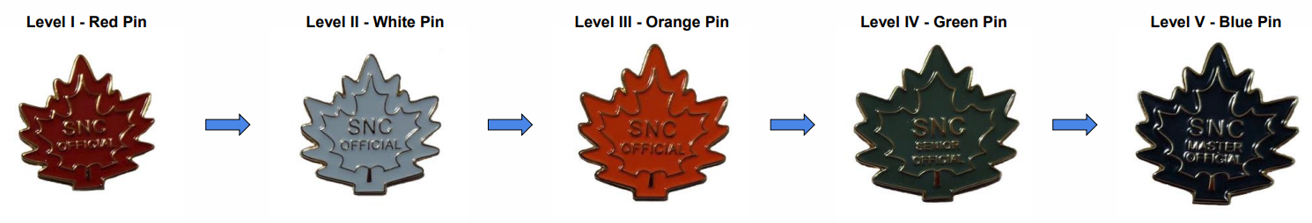
Officials Training
Level I – Red Pin
Level II – White Pin
Level III – Orange Pin
Level IV – Green Pin
Level V – Blue Pin
*Full information on the Officials Certification Pathway can be found here:
https://www.swimming.ca/wp-content/uploads/2026/03/Officials-Certification-Pathway-Mar-2026-EN-FR.pdf

Slide 19
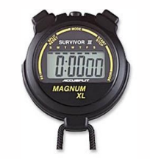
Level I – Red Pin
Complete the Introduction to Swimming Officiating clinic
Complete the Safety Marshal clinic
Complete registration in the Swimming Canada Officials Registration System

Slide 20
Level II – White Pin
Certify in Level I by obtaining 2 successful deck evaluations as a Timekeeper
Complete the Judge of Stroke clinic AND Inspector of Turns clinic and obtain 2 successful deck evaluations (1 as Stroke and 2 as Turn)
Complete one other Level II clinic and obtain 2 successful deck evaluations
  Chief Timekeeper
  Clerk of Course
  Chief Finish Judge (CFJ) / Chief Judge Electronics (CJE)
  Meet Manager
  Starter

Slide 21
SWAT Volunteer Requirements
Group Name | First Child | Second Child
Sr Atlantic & Provincial | $500.00 | $400.00
Sr Development | $500.00 | $400.00
Junior | $400.00 | $320.00
Novice | $300.00 | $240.00
Mini & Tidal Waves | $200.00 | $160.00
Para | $300.00 | $240.00
**If commitment is not met during the season, payment will be pulled in July/August

Slide 22
How to obtain volunteer points
Volunteer on the Board or Non-Board positions
  Some positions cover the entire family's commitment for the season
Volunteer as an Official
  Timer – 1 session = $50
  All other roles – 1 session = $100
Complete an Officials clinics
  Varies depending on level of clinic
More information on ways to obtain points and all of SWATs policies can be found under Member Information (when signed in):
https://swat.poolq.net/menu/team-policies

Slide 23
SWAT Hosted Meets
Important dates for volunteering:
Oct 24th: NT#1 Central – Dalplex pool (1 session), afternoon
Nov 13-15: NT#2 & AGD #2
NT#2 Centennial pool (Nov 14 1 session)
AGD#2 Dalplex (Nov 13-15 4 sessions Fri 4-8pm, Sat 1-445pm,
Sat 5-830pm, Sun AM)
Feb 25-28: LCM ECC Champs – Dalplex pool (7 sessions)**
**This meet is an ALL HANDS ON DECK request. Please commit to 2 sessions if at all possible. Whether you have swimmers attending or not.
**You can gain volunteer points for officiating at ANY meet

Slide 24
How to report your volunteer points
If you volunteer at swim meets or take officials courses, you will need to report your points to our SWAT Points Coordinator.
All you need to do is email Sue at volunteerpoints@swatswim.ca and include the following information:
For swim meets:
Full name, your Officials level and number of sessions
For courses:
Full name, course name and level
**Please email right after the meet/course is completed

Slide 25

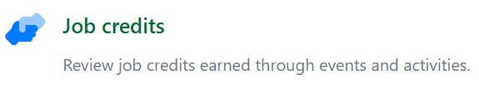
How to check your points
Sign into your account on our website
At the top right under your email address, click “My account”
Click on the icon for which points you wish to review and be sure to select the correct season for Volunteering.
Fundraising:
Volunteering:

Slide 26
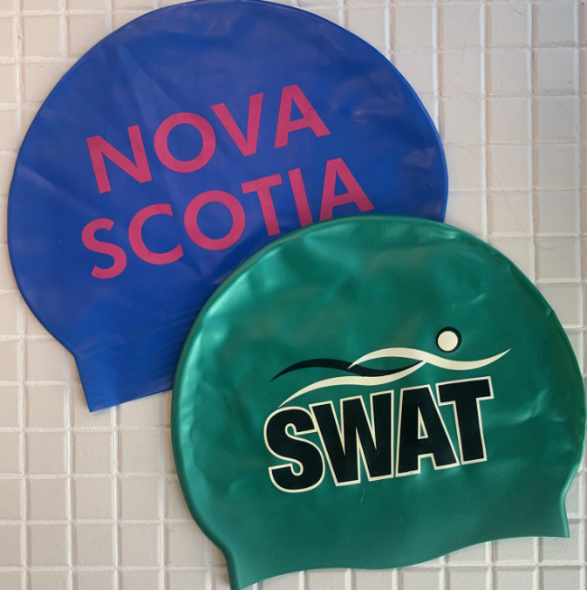
Equipment
Mini Waves:
Training suit (one piece for girls, jammer or brief for boys)
Swim Cap (one included in registration each year)
Goggles
Water bottle
Junior sized kick board (optional)

Slide 27
Equipment
Tidal Waves:
Training suit (one piece for girls, jammer or brief for boys
Swim Cap (one included in registration each year)
Goggles
Water bottle
Junior sized kick board
Short swim fins

Slide 28
Equipment
Novice
Training suit (one piece for girls, jammer or brief for boys)
Swim Cap (one included in registration each year)
Goggles
Water bottle
Junior sized kick board
Short swim fins
Swim snorkel

Slide 29

Questions?

